Slide 1

Basic Details of the Team and Problem Statement
Ministry/Organization Name/Student Innovation: Ministry of
Rural Development
PS Code: SH1018
Problem Statement Title: Analytics tool to provide detail reports on the grading between NQM and SQM
Team Name: Loads of Logic
Team Leader Name: Dharshini V Institute Code (AISHE): C-16526
Institute Name: Sri Venkateswaraa College of Technology
Theme Name: Create a way to connect

Slide 2
Idea/Approach Details
Describe your idea/Solution/Prototype here:
Our idea is to collect and analyze the data given by the NQM and SQM and to find out the quality of the road by applying concepts of Machine learning, Data Analytics and Statistics.
In this we can obtain the analyzed data in a graphical representation, so that we can interpret the correctness of the grading provided by the NQM and SQM.
In this we need to acquire the different set of inputs, so that
we can provide the exact difference between their grading.
Our main goal is to analyze the data and to present the quality of the road in the graphical representation and to find out the variance.
Describe your Technology stack here:
We will be using Machine learning(Python), Data Analytics (Python) and Statistics (Python) are the concepts used for analyzing with the packages Numpy, Pandas, Streamlit and many more.
2

Slide 3
Idea/Approach Details
Describe your Use Cases here
In this model , first we have to provide the variance of inputs, therefore we can find out the exact difference between the grading.
On the basis of the data we can provide provide insights of the data so that concerned division can take up a corrective decision.
On the basis of the grading provided by the NQM and SQM , inputs need to be customized and must perform preprocessing.
Describe your Dependencies / Show stopper here
Data Extraction and input customization from dataset, initial seeding of features is a tedious process.
Model creation and compilation phase are tightly coupled one, during initial stage of building a model the feature extraction phase and associate attribute selection is also a complex task( clustering, regression).
To provide the data analysis on the same in the graphical manner, design a model evaluation and compile the training and testing set.
Validate and evaluate the model based on the
NQM and SQM .
⮚
4

Slide 4
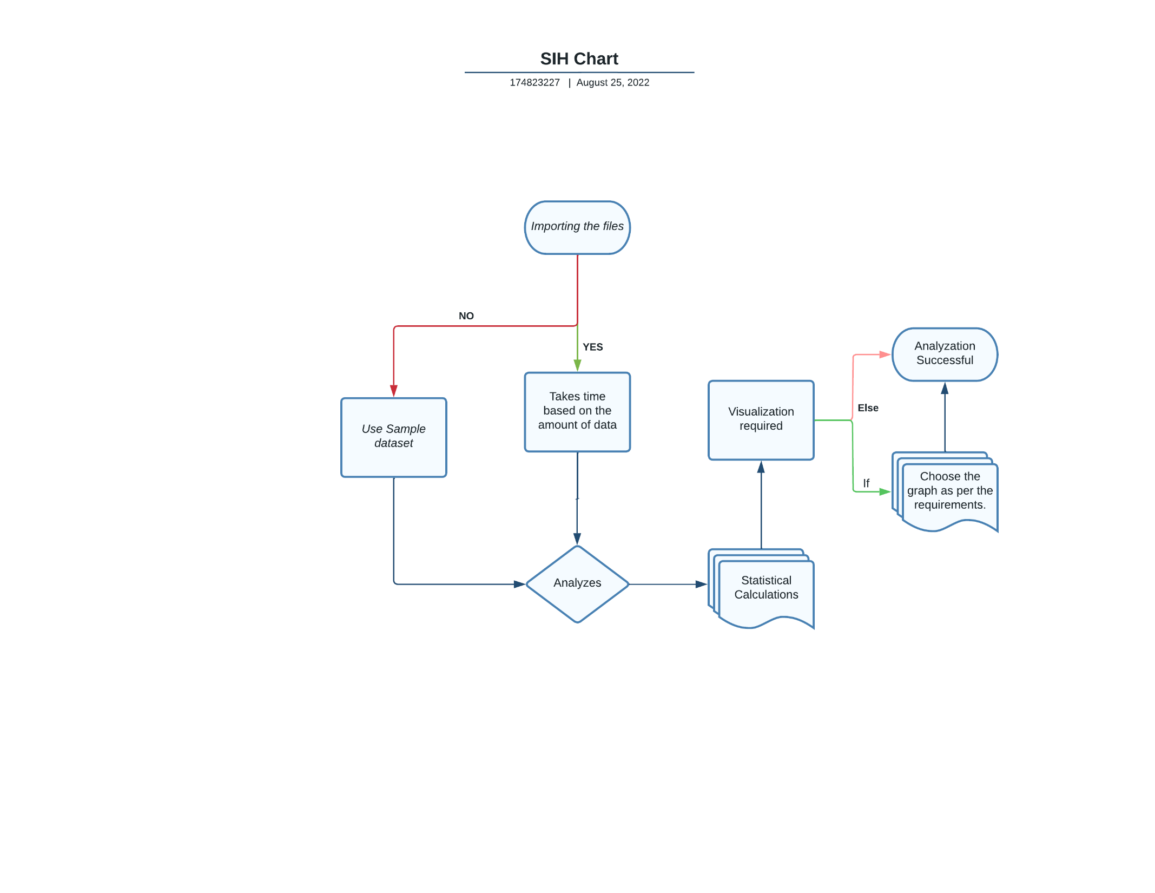
Process Flow Chart
3

Slide 5
First Review Meeting Challenges
Challenges laid out in first review
Create a Sample dataset by understanding parameters on our own based on some of the commonly seen features.
Fill the missing data with some random values which can be either mean, median or mode.
Add Content to the main page such that any individual who uses the website can access the values with ease.
Solutions we have come through
A Sample dataset with some sample parameters based on our knowledge and some basic study had been created.
To handle the missing values we have said that we will be using Scikit-learn package but as scikit learn package may use some more memory. We decided to use pandas which is already been used for various purposes in the Web App.
The content in the main page is being decided by the team mates. We will make sure that this acts as a user manual for the one who uses the Web App fir the first time.
4

Slide 6
Second Review Meeting Challenges
Challenges laid out in second review
Create a Machine Learning model that can predict whether the road quality is either Good or bad based on the parameters that are fed in.
Solutions we have come through
This was achieved by using one of the popular Machine Learning model called Logistic Regression.
The Model works in such a way that based on the number of input (features) given it predicts a singular value which is either Good(1) or Bad (0)
With the help of this model we have fed in some parameters that determine the quality of roads and based on this values we get the output which may be Good or Bad depending upon the data.
4

Slide 7
Our Goal towards the end…
To build an Web app that is accessible to the users using it to understand about the quality of the road they are travelling.
To provide analytics that can show simple statistical calculations such as Maximum, Minimum, Mean, Median etc…
To provide a Easily understandable graphical representation of the data. For this to be practically implemented instead of using traditional Plotting libraries such as Matplotlib or Seaborn we decided to use a Python package called Plotly which is much more interactive and can provide detailed representation of the Plots.

Slide 8
Team Member Details
Team Leader Name : Dharshini V
Branch : B.Tech | Stream : AI & DS | Year :III
Team Member 1 Name : Priyadharshini P
Branch : B.Tech | Stream : AI & DS | Year :I II
Team Member 2 Name : Srilekha S Branch : B.Tech | Stream : AI & DS | Year : I II
Team Member 3 Name : Deepa H
Branch : B.Tech | Stream : AI & DS | Year : I II
Team Member 4 Name : Sanjay Babu V S
Branch : B.Tech | Stream : AI & DS | Year : I II
Team Member 5 Name : Priyadharshini M
Branch : B.Tech | Stream : AI & DS | Year : I II

